Slide 1

Anti-Malware Plan for Good Nutrition
Network Insecurity

Slide 2

Definition of malware
A malware is any software that is deliberately designed and build to cause damage to a computer system or a computer server or simply the network.
The system network has been attacked by a worm malware.
Notes:
A worm is capable of self-replicating itself and spreading from one computer to the next within connected network system without any human action required.

Slide 3
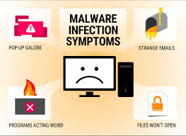
Dangers of Malware
Worms silently starts to work and infects a computer system without the user’s knowledge.
Worms are capable of modifying and deleting files.
Worms can even end up injecting additional malicious software into a computer system.
They deplete systems resources such as bandwidth.
They overload the shared network.
Notes:
Worms are capable of entering into the network system without the knowledge of the user. Once its gets into the system, it replicates itself and thus fills the available space.

Slide 4
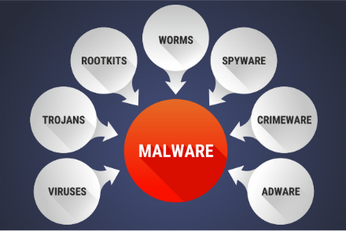
Types of Malware
Notes:
There are different types of malware which includes; viruses, Trojans, adware, and worms among others.

Slide 5

Proactive Measures to Prevent Malware
The employees should keep an eye on the computer’s hard drive space.
When the workers detect any files replicating themselves, they should alert the IT experts within the facility.
The workers will be monitoring the speed and performance of their computers and the whole system. Malware makes the network system to work slow.
The employees will be on the lookout for any missing or new files.
Notes:
The organization’s employees working with the system will be on the look out for any signs of malware infection. They will be looking at any new or lost file and also the speed of the network. Malware makes the network system to work slow

Slide 6

Proactive Measures cont…
Ensure the computer’s operating system and other applications are up to date with the latest versions.
Getting extra cautious when opening unsolicited emails; avoid opening emails from unknown senders.
Ensure that there is a strong internet security software solution which can assist in blocking these malware threats.
Notes:
The employees will ensure that the system is updated on regular basis so that they can ensure that the system is not vulnerable to threats. They will also be extra cautios with new documents from unknown senders in order to help in minimizing the chances of the system being infected.

Slide 7
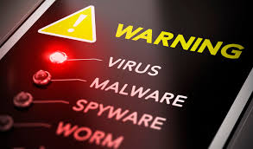
IT Practices
Installation of antivirus.
Ensure anti-virus is up-to-date; the anti-virus software should be maintained.
Ensure that there are regular scans scheduled using the antivirus software.
Ensure that the network is secured; secure the system with a strong password.
Notes:
Antivirus helps in blocking the malware that are send into the system. It will also alert of an impending virus attack. Once it has alerted the user, the user should take the necessary measures to ensure protection.

Slide 8
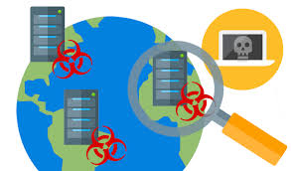
IT Policies
Ensure that there are no two anti-malware software running concurrently.
Ensure that the anti-virus program allows for updates.
Ensure that the anti-virus software updates itself on regular basis.
Allow the anti-virus to be on always.
Notes:
There should always be an anti-virus software running at all times and it should be updated on regular basis. It can be set in such a way that it will update itself automatically.

Slide 9
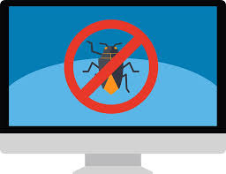
Software
Norton security; offers both great value and robust defense for effective protecting against dangerous malwares.
Avast interne security; it protects the system from malwares from any malicious sources. It scans all files and email attachments for any malicious threats.
Kaspersky anti-virus; it is a program that was designed to protect the users from malware and is mainly designed from computers running on MacOs and Microsoft Windows.
Notes:
There are various software that have been developed to protect computers and network system from getting infected with virus, worms among other malwares. Some of the software are Norton, Avast and Kaspersky.

Slide 10
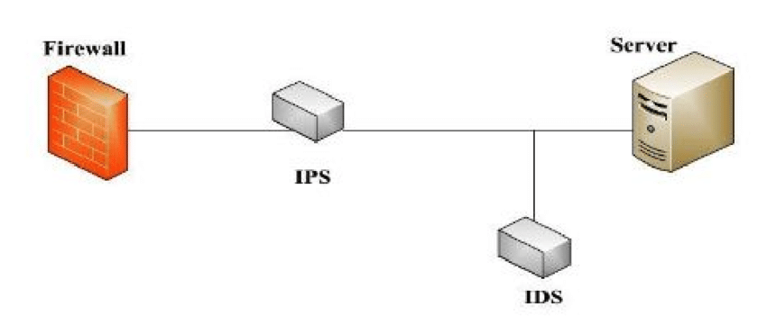
Responsive Measures (IDS &IPS)
An IDS (intrusion detection system) refers to a network security technology that is produced for detecting vulnerability exploits against a computer or a certain application.
It alerts the administrators when someone is strong to compromise information system.
Can be compromised either via security violation or malicious activities.
Notes:
There could be found vulnerable points within the network system. The IDS helps in detecting such vulnerability and once it does so, it alerts the administrators.

Slide 11

IPS
IPS refers to a preemptive approach to network security used to identify potential threats and responds to them as required.
IPS is found between in the same areas of the network as a firewall, between the internal network and the outside world.
IPS deny network traffic-based on a security profile if the packet shows some known security threats.
Notes:
The IPS denies network traffic-based on a security profile. They respond to the threats identifies as needed.

Slide 12
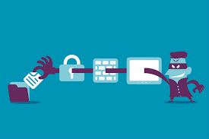
Comparison between IDS and IPS
IDS analyses and monitors network traffic for signs which show attackers are using known cyber threats to hack into the system to steal data.
It detects behaviors such as ports scanners, malware, and violations of security policies.
Notes:
IDS is the best for this case since it detects behaviors such as malware and others. This case involves malware detection.

Slide 13
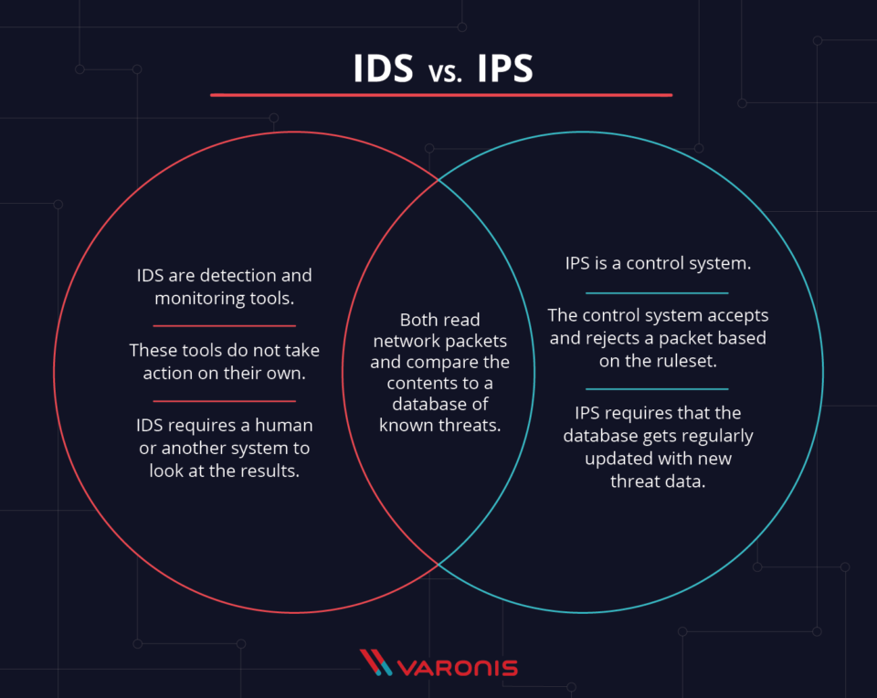
Comparison between IDS and IPS
Notes:
The key difference between IPS and IDS is that IDS is a monitoring system whereas IPS is a control system.

Slide 14
References
Buecker, A., & International Business Machines Corporation. (2011). Network intrusion prevention design guide: Using IBM security network IPS.
Brotherston, L., & Berlin, A. (2017). Defensive security handbook: Best practices for securing infrastructure.

